Slide 1
Chapter 2
Evolution of the Major Programming Languages

Slide 2
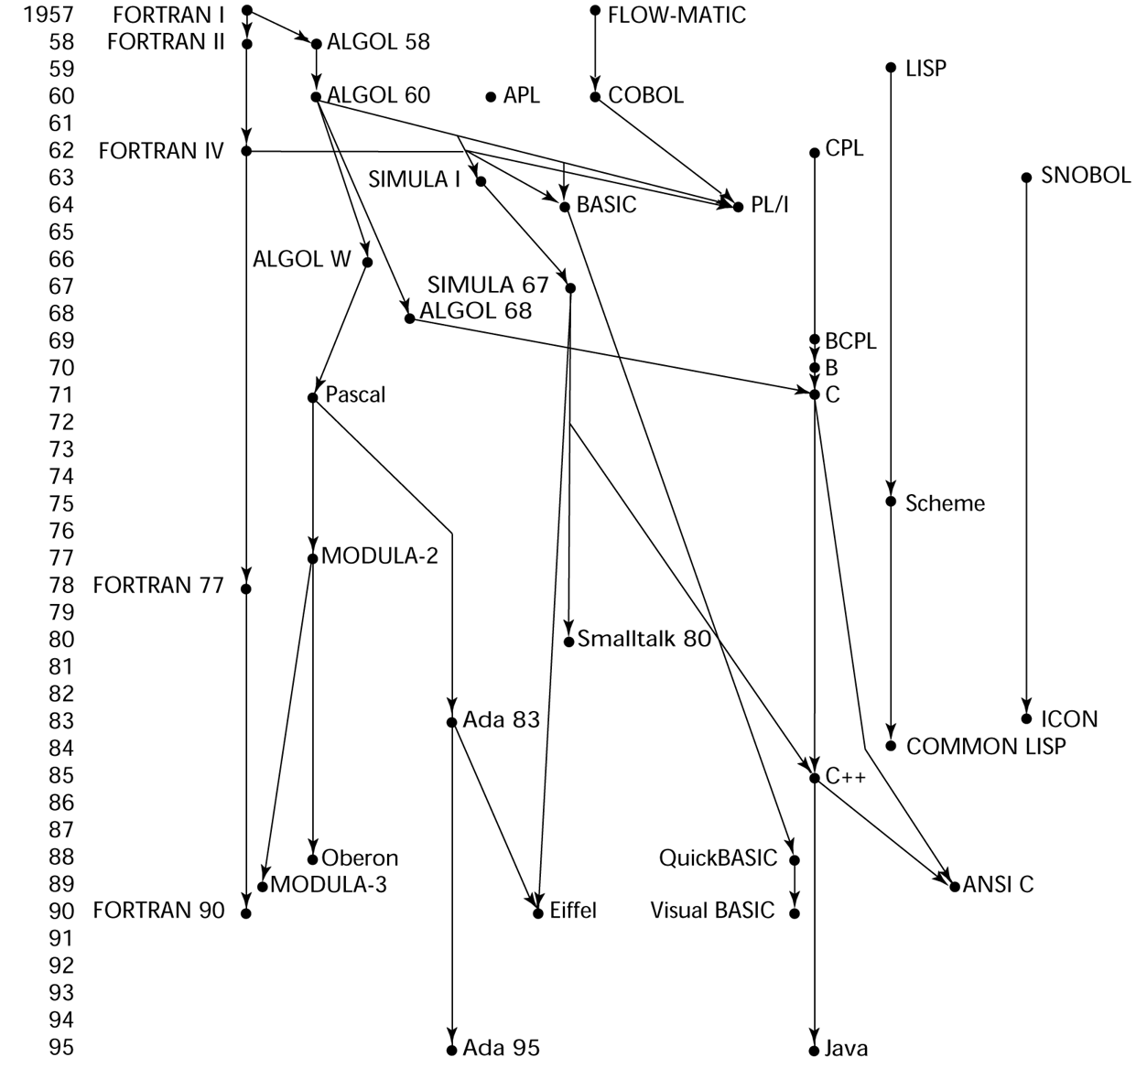
Genealogy of Common Languages

Slide 3
Zuse’s Plankalkül
Designed in 1945, but not published until 1972
Never implemented
Advanced data structures
floating point, arrays, records
Invariants

Slide 4
Plankalkül Syntax
An assignment statement to assign the expression A[4] + 1 to A[5]
| A + 1 => A
V | 4 5 (subscripts)
S | 1.n 1.n (data types)

Slide 5
Minimal Hardware Programming: Pseudocodes
What was wrong with using machine code?
Poor readability
Poor modifiability
Expression coding was tedious
Machine deficiencies--no indexing or floating point

Slide 6
Pseudocodes: Short Code
Short Code developed by Mauchly in 1949 for BINAC computers
Expressions were coded, left to right
Example of operations:
01 – 06 abs value
02 ) 07 +
03 = 08 pause
04 / 09 (
50 times slower than machine code
Interpretation

Slide 7
Pseudocodes: Speedcoding
Speedcoding developed by Backus in 1954 for IBM 701
Pseudo ops for arithmetic and math functions
Conditional and unconditional branching
Auto-increment registers for array access
Slow!
Only 700 words left for user program

Slide 8
Pseudocodes: Related Systems
The UNIVAC Compiling System
Developed by a team led by Grace Hopper
Pseudocode expanded into machine code subprograms
David J. Wheeler (Cambridge University)
developed a method of using blocks of re-locatable addresses to solve the problem of absolute addressing

Slide 9
IBM 704 and Fortran
Fortran 0: 1954 - not implemented
Fortran I:1957
Designed for the new IBM 704, which had index registers and floating point hardware
- This led to the idea of compiled programming languages, because there was no place to hide the cost of interpretation before (no floating-point hardware)
Environment of development
Computers were small and unreliable
Applications were scientific
No programming methodology or tools
Machine efficiency was the most important concern

Slide 10
Design Process of Fortran
Computers had
Small memories, slow, and unreliable
Primary use was scientific
Speed of object code was primary concern
Impact of environment
No need for dynamic storage
Need good array handling and counting loops
No string handling, decimal arithmetic, or powerful input/output (for business software)

Slide 11
Fortran I Overview
First implemented version of Fortran
Names could have up to six characters
Post-test counting loop (DO)
Formatted I/O
User-defined subprograms
Three-way selection statement (arithmetic IF)
No data typing statements
Integer if starts with I, J, K, L, M, N
Floating point all others.

Slide 12
Fortran I Overview (continued)
First implemented version of FORTRAN
Half of the code in IBM 704 was written in Fortran
Compiler released in April 1957
Programs larger than 400 lines rarely compiled correctly, mainly due to poor reliability of 704
Code was very fast
Quickly became widely used

Slide 13
Fortran II
Distributed in 1958
Independent compilation introduced
So you don’t have to compile whole program if you change only one function
Fixed the bugs

Slide 14
Fortran IV
Evolved during 1960-62
Explicit type declarations
Logical selection statement
Subprogram names could be parameters

Slide 15
Fortran 77
Became the new standard in 1978
Character string handling
Logical loop control statement
IF-THEN-ELSE statement

Slide 16
Fortran 90
Most significant changes from Fortran 77
Modules
Dynamic arrays
Pointers
Recursion
CASE statement
Parameter type checking

Slide 17
Latest versions of Fortran
Fortran 95 – relatively minor additions, plus some deletions
Fortran 2003 – support for OOP, procedure pointers, interoperability with C
Fortran 2008 – blocks for local scopes, co-arrays, Do Concurrent

Slide 18
Fortran Evaluation
Highly optimizing compilers (all versions before 90)
Types and storage of all variables are fixed before run time
Dramatically changed forever the way computers are used

Slide 19
Functional Programming: LISP
LISt Processing language
Designed at MIT by McCarthy
AI research needed a language to
Process data in lists (rather than arrays)
Symbolic computation (rather than numeric)
Only two data types: atoms and lists
Syntax is based on lambda calculus

Slide 20
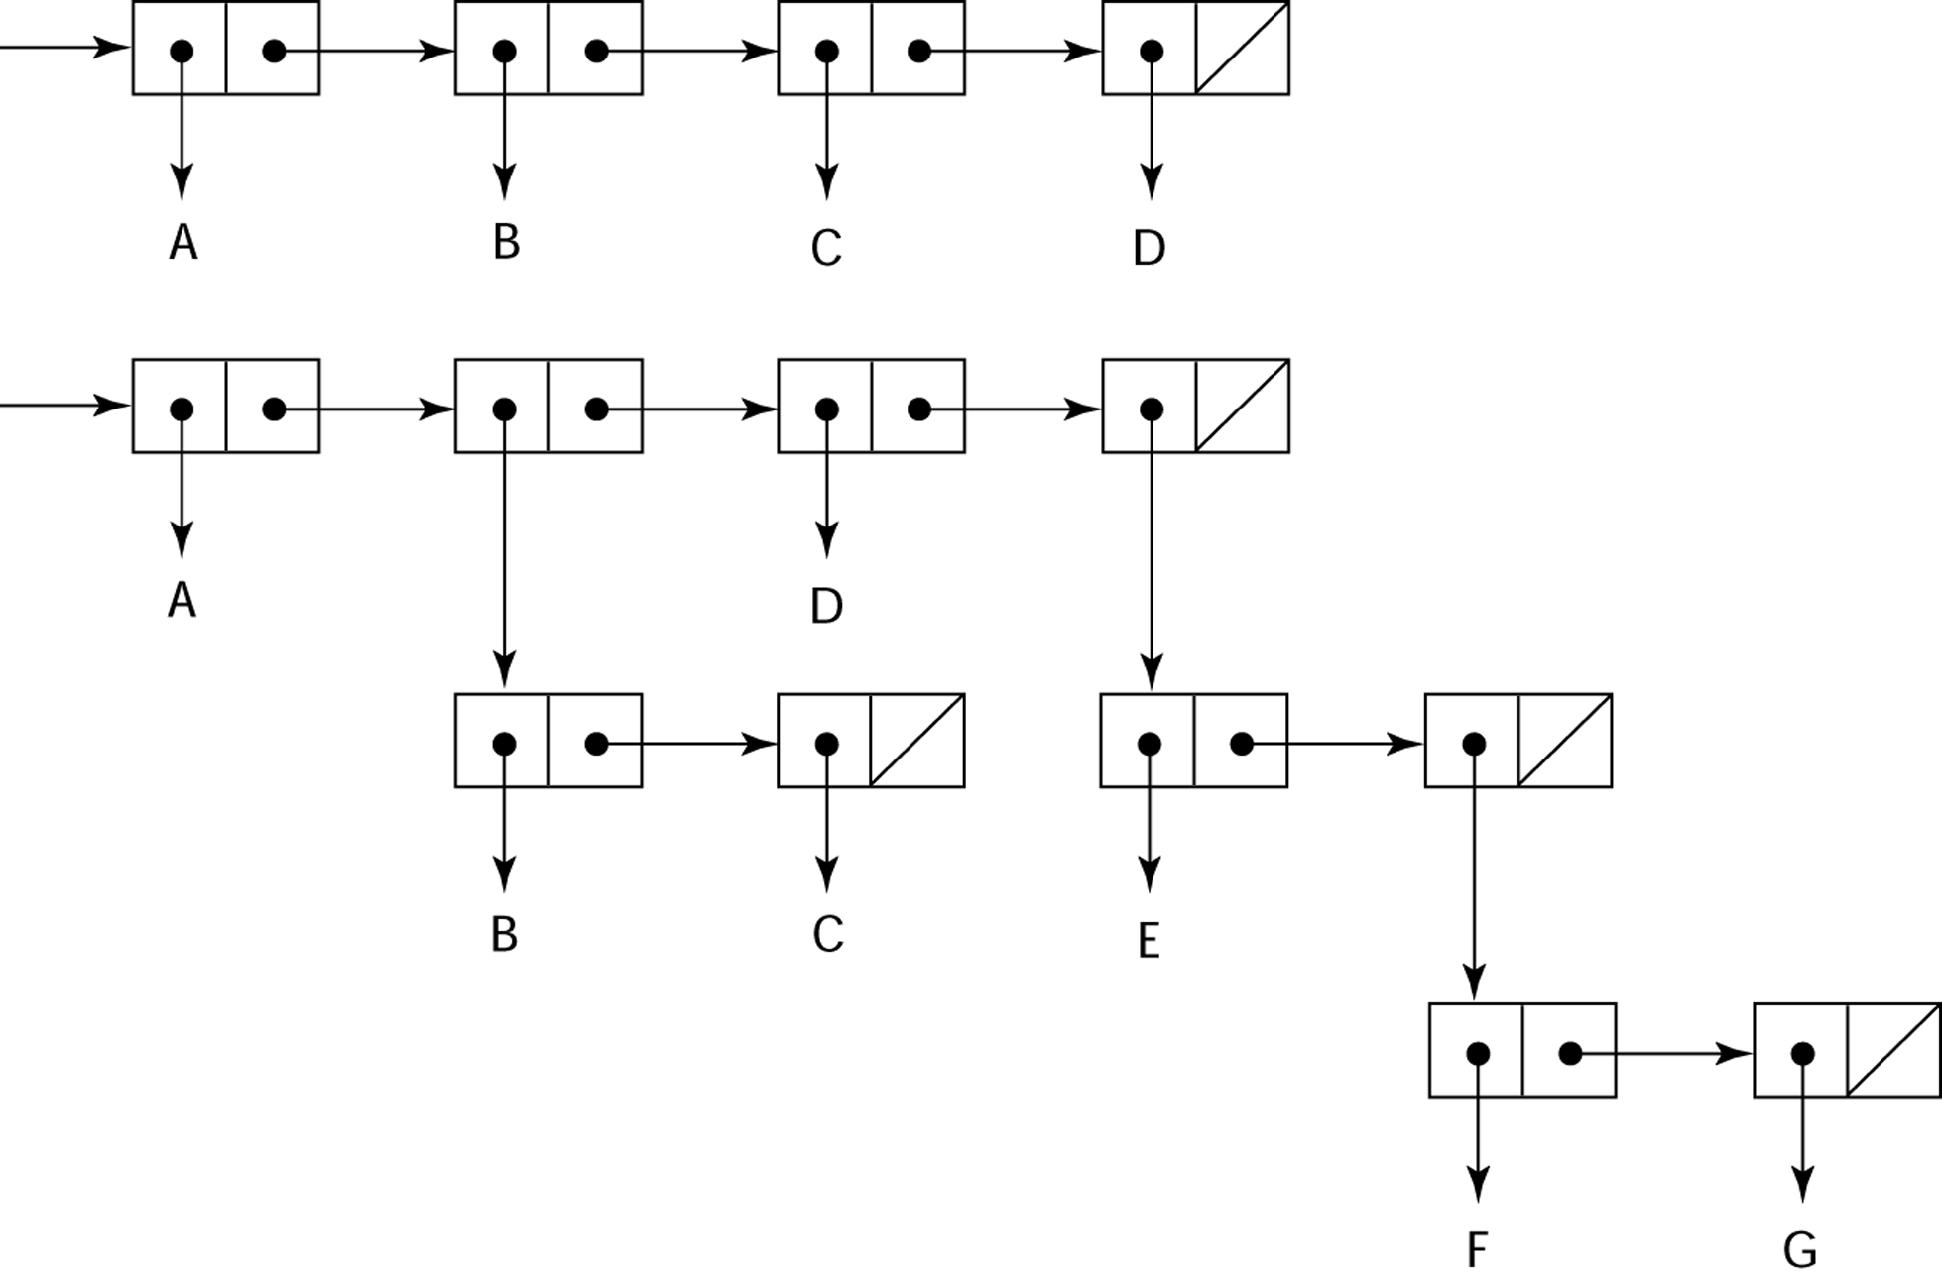
Representation of Two LISP Lists
Representing the lists (A B C D)
and (A (B C) D (E (F G)))

Slide 21
LISP Evaluation
Pioneered functional programming
No need for variables or assignment
Control via recursion and conditional expressions
Still the dominant language for AI
COMMON LISP and Scheme are contemporary dialects of LISP
ML, Haskell, and F# are also functional programming languages, but use very different syntax

Slide 22
Scheme
Developed at MIT in mid 1970s
Small
Extensive use of static scoping
Functions as first-class entities
Simple syntax (and small size) make it ideal for educational applications

Slide 23
COMMON LISP
An effort to combine features of several dialects of LISP into a single language
Large, complex, used in industry for some large applications

Slide 24
The First Step Toward Sophistication: ALGOL 60
Environment of development
FORTRAN had (barely) arrived for IBM 70x
Many other languages were being developed, all for specific machines
No portable language; all were machine- dependent
No universal language for communicating algorithms
ALGOL 60 was the result of efforts to design a universal language

Slide 25
Early Design Process
ACM and GAMM met for four days for design (May 27 to June 1, 1958)
Goals of the language
Close to mathematical notation
Good for describing algorithms
Must be translatable to machine code

Slide 26
ALGOL 58
Concept of type was formalized
Names could be any length
Arrays could have any number of subscripts
Parameters were separated by mode (in & out)
Subscripts were placed in brackets
Compound statements (begin ... end)
Semicolon as a statement separator
Assignment operator was :=
if had an else-if clause
No I/O - “would make it machine dependent”

Slide 27
ALGOL 58 Implementation
Not meant to be implemented, but variations of it were (MAD, JOVIAL)
Although IBM was initially enthusiastic, all support was dropped by mid 1959

Slide 28
ALGOL 60 Overview
Modified ALGOL 58 at 6-day meeting in Paris
New features
Block structure (local scope)
Two parameter passing methods
Subprogram recursion
Stack-dynamic arrays
Still no I/O and no string handling

Slide 29
ALGOL 60 Evaluation
Successes
It was the standard way to publish algorithms for over 20 years
All subsequent imperative languages are based on it
First machine-independent language
First language whose syntax was formally defined (BNF)

Slide 30
ALGOL 60 Evaluation (continued)
Failure
Never widely used, especially in U.S.
Reasons
Lack of I/O and the character set made programs non-portable
Too flexible--hard to implement
Entrenchment of Fortran
Formal syntax description
Lack of support from IBM

Slide 31
COmmon Business-Oriented Language: COBOL
Environment of development
UNIVAC was beginning to use FLOW-MATIC
USAF was beginning to use AIMACO
IBM was developing COMTRAN

Slide 32
COBOL Historical Background
Based on FLOW-MATIC
FLOW-MATIC features
Names up to 12 characters, with embedded hyphens
English names for arithmetic operators (no arithmetic expressions)
Data and code were completely separate
The first word in every statement was a verb

Slide 33
Shortest COBOL Code
$ SET SOURCEFORMAT"FREE"
IDENTIFICATION DIVISION.
PROGRAM-ID. ShortestProgram.
PROCEDURE DIVISION.
DisplayPrompt.
DISPLAY "I did it".
STOP RUN.

Slide 34
COBOL Design Process
First Design Meeting (Pentagon) - May 1959
Design goals
Must look like simple English
Must be easy to use, even if that means it will be less powerful
Must broaden the base of computer users
Must not be biased by current compiler problems
Design committee members were all from computer manufacturers and DoD branches
Design Problems: arithmetic expressions? subscripts? Fights among manufacturers

Slide 35
COBOL Evaluation
Contributions
First macro facility in a high-level language
Hierarchical data structures (records)
Nested selection statements
Long names (up to 30 characters), with hyphens
Separate data division

Slide 36
COBOL: DoD Influence
First language required by DoD
would have failed without DoD
Still the most widely used business applications language

